Slide 1
Inheritance in Java
Inheritance in Java is a mechanism in which one object acquires all the properties and behaviors of a parent object.
When you inherit from an existing class, you can reuse methods and fields of the parent class. Moreover, you can add new methods and fields in your current class also.
Inheritance represents the IS-A relationship which is also known as a parent-child relationship.
Why use inheritance in java
For Method Overriding (so runtime polymorphism can be achieved).
For Code Reusability.
Terms used in Inheritance
Class: A class is a group of objects which have common properties. It is a template or blueprint from which objects are created.
Sub Class/Child Class: Subclass is a class which inherits the other class. It is also called a derived class, extended class, or child class.
Super Class/Parent Class: Superclass is the class from where a subclass inherits the features. It is also called a base class or a parent class.
Reusability: As the name specifies, reusability is a mechanism which facilitates you to reuse the fields and methods of the existing class when you create a new class. You can use the same fields and methods already defined in the previous class.

Slide 2
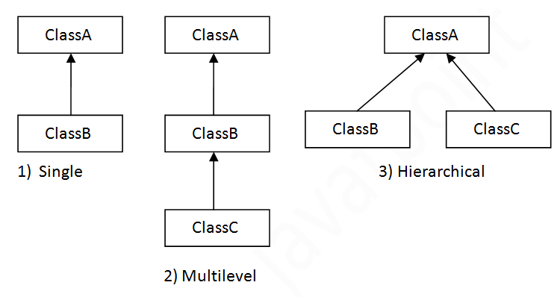
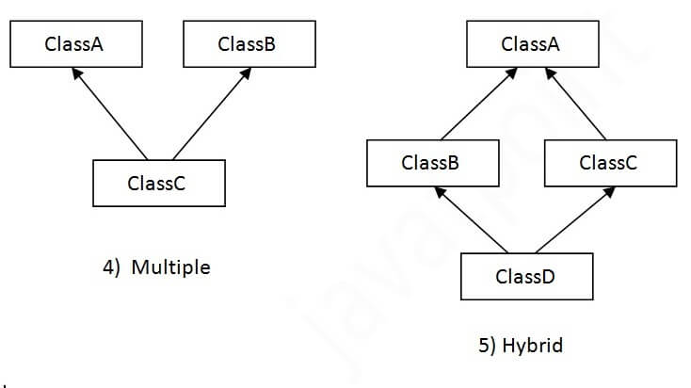
Types of inheritance in java

Slide 3
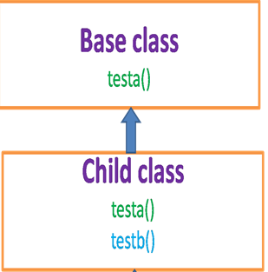
The syntax of Java Inheritance
class Subclass-name extends Superclass-name
{
//methods and fields
}
The meaning of "extends" is to increase the functionality.
class Animal{
void eat()
{
System.out.println("eating...");
}
}
class Dog extends Animal
{
void bark(){System.out.println("barking...");
}
}
class TestInheritance
{
public static void main(String args[])
{
Dog d=new Dog();
d.bark();
d.eat();
}
}

Slide 4
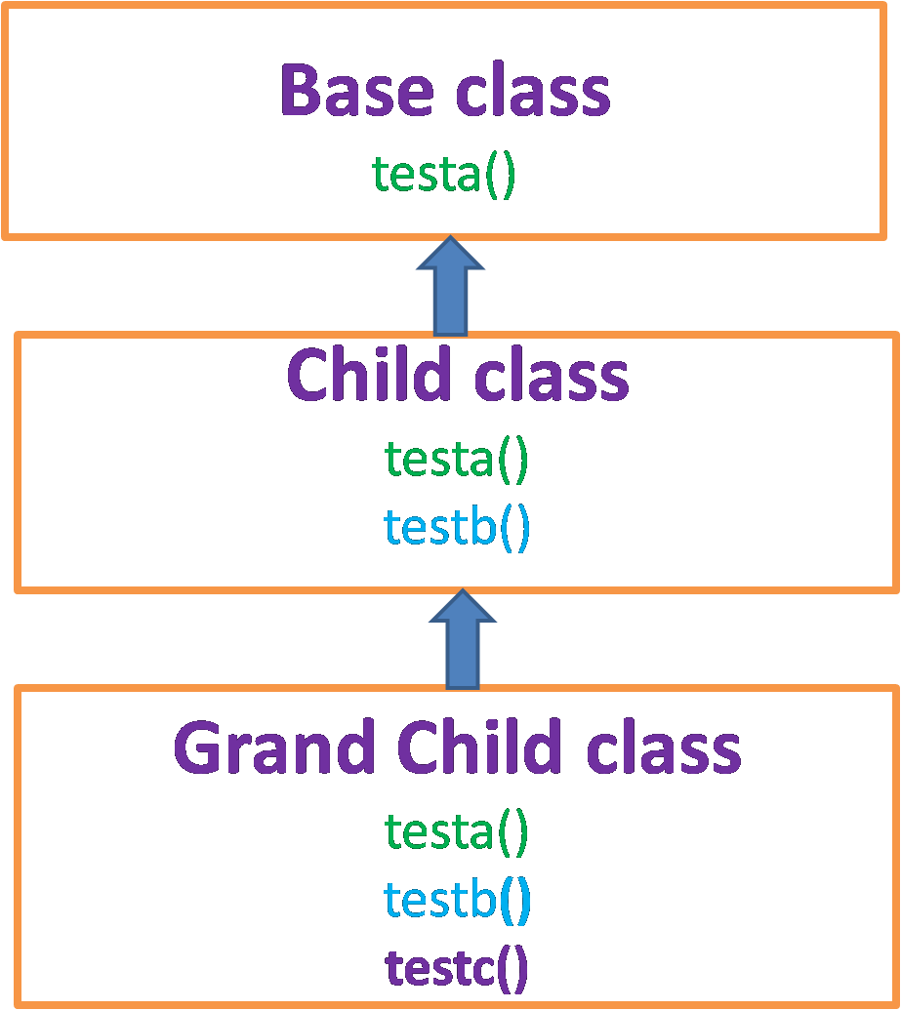
Multilevel Inheritance Example
When there is a chain of inheritance, it is known as multilevel inheritance. As you can see in the example given below,
class Animal{
void eat()
{
System.out.println("eating...");
}
}
class Dog extends Animal{
void bark()
{
System.out.println("barking...");
}
}
class BabyDog extends Dog
{
void weep()
{
System.out.println("weeping...");
}
}
class TestInheritance2{
public static void main(String args[]){
BabyDog d=new BabyDog();
d.weep();
d.bark();
d.eat();
}}

Slide 5
Hierarchical Inheritance Example
When two or more classes inherits a single class, it is known as hierarchical inheritance. In the example given below, Dog and Cat classes inherits the Animal class, so there is hierarchical inheritance.
class Animal{
void eat()
{
System.out.println("eating...");
}
}
class Dog extends Animal{
void bark()
{
System.out.println("barking...");
}
}
class Cat extends Animal
{
void meow(){
System.out.println("meowing...");
}
}
class TestInheritance3{
public static void main(String args[]){
Cat c=new Cat();
c.meow();
c.eat();
//c.bark();//C.T.Error
}}

Slide 6
Why multiple inheritance is not supported in java?
To reduce the complexity and simplify the language, multiple inheritance is not supported in java.
Consider a scenario where A, B, and C are three classes. The C class inherits A and B classes. If A and B classes have the same method and you call it from child class object, there will be ambiguity to call the method of A or B class.
Since compile-time errors are better than runtime errors, Java renders compile-time error if you inherit 2 classes. So whether you have same method or different, there will be compile time error.
class A
{
void msg()
{
System.out.println("Hello");
}
}
class B{
void msg()
{
System.out.println("Welcome");
}
}
class C extends A,B
{
}
Class mainclass
{
public static void main(String args[]){
C obj=new C();
obj.msg();//Now which msg() method would be invoked?
}
}

Slide 7
Final keyword
If you don’t want class to be inherited then declare the class with final.
final class Bike
{
}
class Honda1 extends Bike
{
void run()
{
System.out.println("running safely with 100kmph");
}
}
Class main{
public static void main(String args[])
{
Honda1 honda= new Honda1();
honda.run();
}
} //o/p will be compile time error

Slide 8
task
Create a class named 'Rectangle' with two data members 'length' and 'breadth' and two methods to print the area and perimeter of the rectangle respectively. Its constructor having parameters for length and breadth is used to initialize length and breadth of the rectangle. Let class 'Square' inherit the 'Rectangle' class with its constructor having a parameter for its side (suppose s) calling the constructor of its parent class as 'super(s,s)'. Print the area and perimeter of a rectangle and a square.

